Slide 1


Slide 2

Police and Prison Civil Rights Union (POPCRU) Republic of South Africa Input to 2nd Congress of Tui for Pensioners 23 February 2019

Slide 3
Current Position of retirement coverage in South Africa
South Africa has more than 13 500 private pension funds which include occupational pension and retirement annuity or personal plan retirement funds.
Like in most developing countries , the South African social insurance system was formalized after the second world war and almost simultaneously with the enactment of legislated racial discrimination called apartheid with the enactment of the South African Pension Funds Act 24 of 1956.
To that extent therefore , the retirement fund landscape still bears the scars of past discrimination to a very great extent.
The 1993 South African Interim Constitution and the 1996 Constitution expressed for the first time social security rights for all South Africans.
Currently only 60% of the formal sector employees are members of retirement funds.

Slide 4
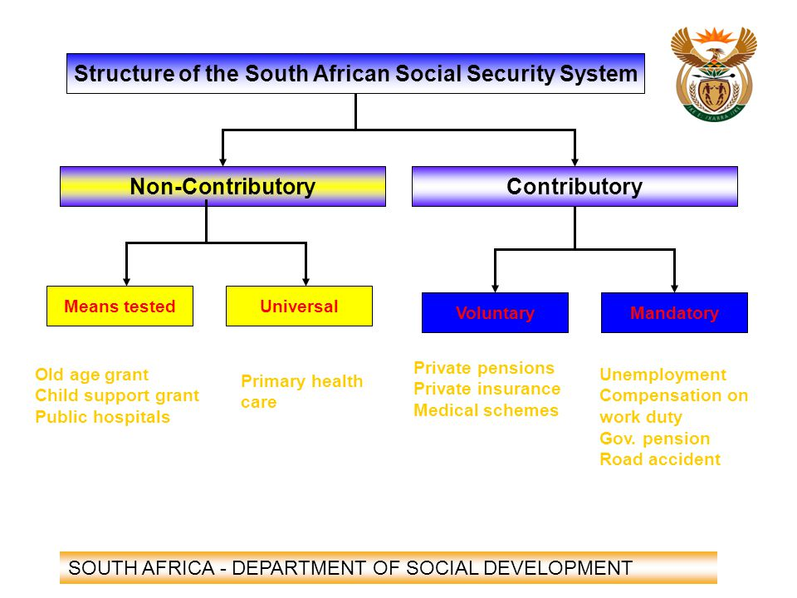

Slide 5
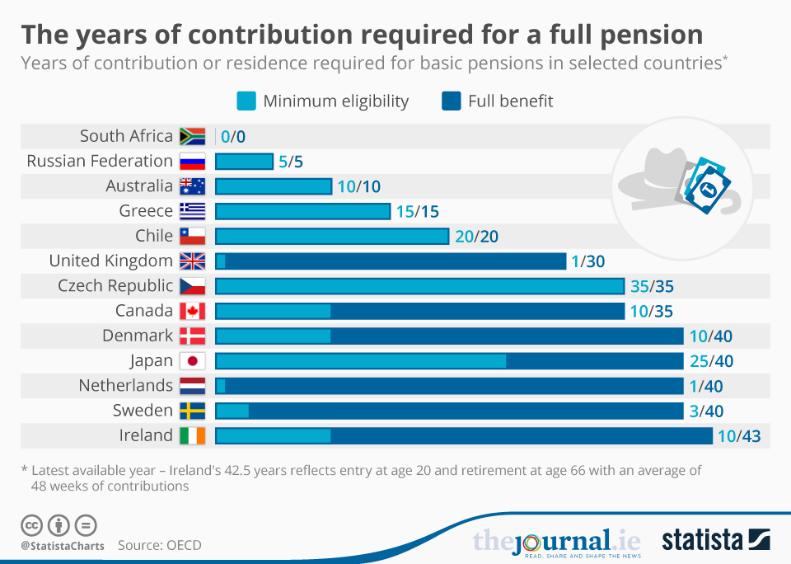

Slide 6
Types of retirement funds in the retirement system in South Africa
There are three basic types of retirement funds in the South African retirement system: pension, provident and retirement annuity funds. Employer contributions to pension funds and provident funds are a non-taxable fringe benefit.
Member or employee contributions to pension funds and retirement annuity funds are tax deductible (subject to limits) for personal income tax purposes.
Pension and retirement annuity fund members are required to annuitize a portion (usually two-thirds, with one-third still available as a lump sum) of their retirement fund saving or interest upon retirement.
Provident fund members are not required to annuitize any portion of fund savings at retirement.
Provident fund members typically receive their retirement benefit as a lump sum upon retirement, and tend to spend it quickly and, therefore, be vulnerable to old-age poverty.

Slide 7
Current Position of retirement coverage in South Africa (Provident Funds)
Like in most countries , Provident Funds differ from pension funds in that the employee can withdraw the entire lump sum of their contributions immediately on retirement, whereas in a pension fund, only one-third of savings can be withdrawn as a lump sum.
The remaining two-thirds of a pension fund, mush be preserved and paid out as an annuity on a monthly basis after retirement , which is not the case with Provident Funds.

Slide 8
Current Position of retirement coverage in South Africa (Occupational Funds)
An employer can provide a pension scheme for its workforce (these are often called occupational funds). The company providing employment will contribute to the Fund and the individual employee can contribute up to 7,5% of their retirement-funding income .
On retirement, the occupational pension fund normally pays an annuity (monthly pension) based on the contributions of the company and the employee to the Fund (defined contributions).
If an individual leaves the company before reaching retirement age, they will be paid out on contributions to the pension fund (plus investment growth). These funds are not subject to compulsory preservation, but if they are transferred into another retirement fund, the tax benefits of such retirement funds are fully preserved.

Slide 9
Current Position of retirement coverage in South Africa (Retirement Annuity Funds)
Retirement Annuity Funds are taken out in the name of the individual member with added tax incentives to encourage members to save further amounts for retirement.
A retirement annuity is much more dependent on the choice of the individual, including a choice
to build up retirement savings of their choice;
to elect when to take retirement (any age after 55); and
to make individual choice of the size of contributions;
to select investment portfolios which suit the risk and maturity profile of the contributor
to stop payments into the RA Fund, or to increase contributions, with no penalties attached.

Slide 10
Proposed by DT Chamburuka et al
 | Who is covered | Benefits | The administrator
Mandatory provision recommended by the Taylor Commission (2002 | All formal employees including casual and part-time workers | Integrated social security system. The savings will be preserved. Members will receive 60% of their pre-unemployed income and this will assist compulsory preservation. | Government
National Savings Fund proposed in 2004 | Low incomes (particularly workers in the informal sector, part-time and seasonal employees, domestic and agricultural workers) | Retirement savings | NSF will be run by government. High income earners can save towards retirement in an approved retirement scheme run by the private sector.
Mandatory provision recommended by National Treasury (2007) | All employees | Partly PAYG defined benefits and partly funded defined contribution | PAYG – Government sponsored retirement fund defined contribution – either government/private sector
National Social Savings Fund | Employees earning between R12 001 and R150 000 | PAYG and on defined basis targeting a net replacement ratio of 40% | Government for the NSSF
Auto-enrolment | All employees in the formal sector | Funded benefits | Private sector (stand alone, umbrella or retirement annuity)

Slide 11
Current Position of retirement coverage in South Africa (Preservation Funds)
A member can decide when leaving a retirement fund before his retirement date to have his contributions be transferred to a preservation fund. The member is allowed to make one withdrawal before the remaining funds are held in the preservation fund until he reaches retirement age.
A member is also allowed to transfer their contributions from a retirement fund to another retirement fund.

Slide 12
Current Position of retirement coverage in South Africa (Preservation Funds)
A member can decide when leaving a retirement fund before his retirement date to have his contributions be transferred to a preservation fund. The member is allowed to make one withdrawal before the remaining funds are held in the preservation fund until he reaches retirement age.
A member is also allowed to transfer their contributions from a retirement fund to another retirement fund.

Slide 13
The Formal Retirement System in a nutshell Source:John Kruger and Boipuso Modise (OPM South Africa)
13
Notes:
13

Slide 14
A changing and aging workforce in Africa?
Contrary to what is happening in continental Europe and elsewhere in the world where the workforce is changing and aging and retirement ages are being , in Africa 60% of the population are below the age of 25.
In a recent 2016 survey 27.3% of African population was between 15 and 29 years with more than 41% under the age of 15 years
It is estimated that by 2030 , of the 8.6 Billion global population , 40 % will be in Africa.
Unlike elsewhere in the world , there is no rush towards retirement ages being scrutinized and in some cases being increased because the population is not aging as it is the case in many countries.

Slide 15
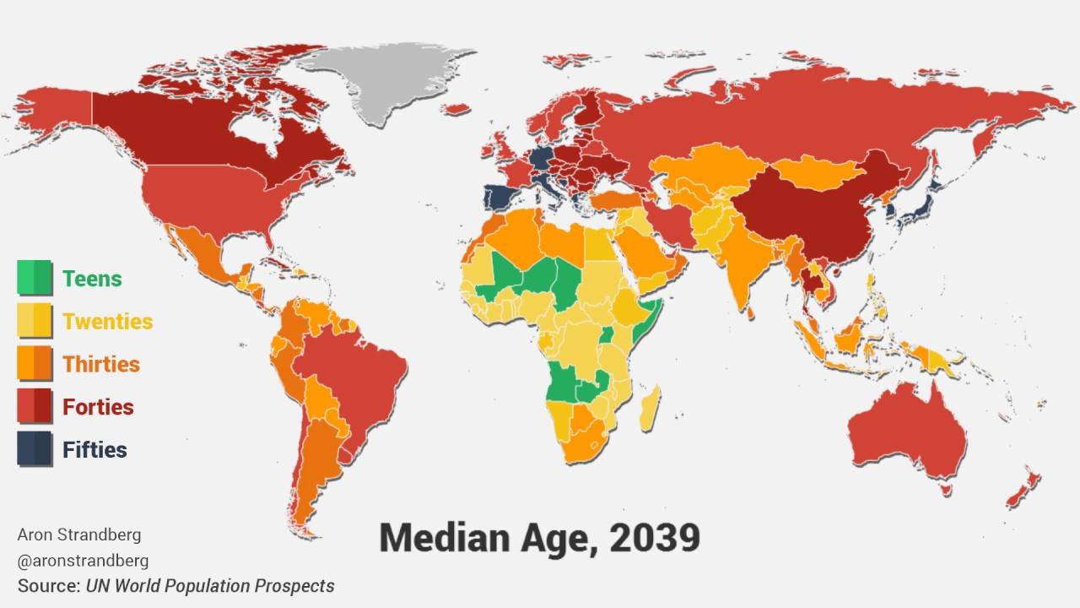
Median Age , 2039

Slide 16
The size of the membership is growing
Whilst elsewhere in the world there has been a decline in pension fund growth , South Africa has registered a phenomenal growth compared to the rest of the world.
A study undertaken in 2014 by Towers Watson Global Pension Asset Study that analyses trends in the pension fund sector shows that South Africa’s grew by 14% and was the highest in the whole world followed by Australia at 12%, Hong Kong at 12% and the United Kingdom at 11%.
The world average is 6.5% over the same period, showing that the South African growth far exceeds market average.
The GEPF is fully funded above 100% and hasn’t revised its retirement age.

Slide 17
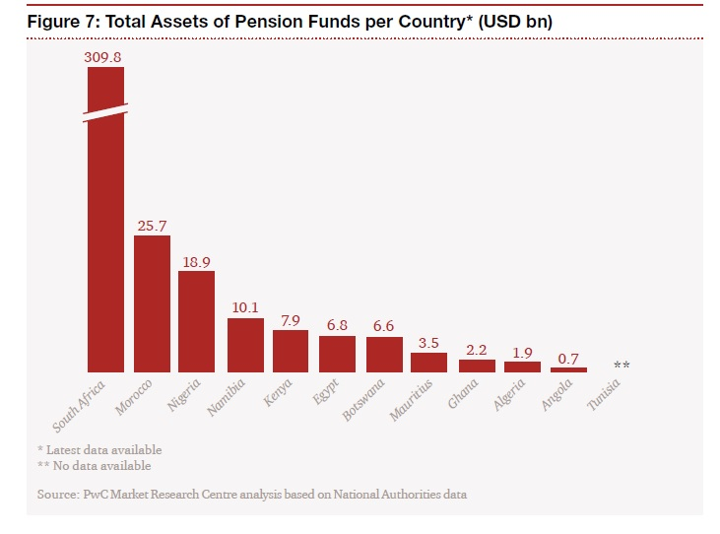

Slide 18
Twin Peaks Implementation
From 1 April 2018 the Financial Services Regulation Act which brings about the implementation of Twin Peaks in South Africa became effective.
The Reserve Bank will be responsible for both micro and macro-prudential regulation and supervision. Micro-prudential regulation aims to secure the safety and soundness of banks, insurers, financial conglomerates and financial market infrastructure.
The new market conduct regulator, formerly the Financial Services Board will oversee the market conduct of all financial services institutions.

Slide 19
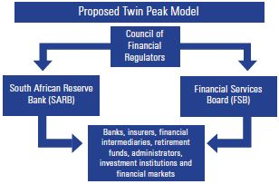

Slide 20
Key Framework Documents
In 2012 Government released a set of key discussion documents aimed at enhancing retirement reform in South Africa:
Retirement fund costs – Reviews the costs of retirement funds and measures proposed to reduce them.
Providing a retirement income – Reviews retirement income markets and measures to ensure that cost-effective, standardised and easily accessible products are available to the public.
Preservation, portability and uniform access to retirement savings – Gives consideration to phasing in preservation on job changes and divorce settlement orders, and harmonising annuitisation requirements. The aim is to strengthen retirement provisioning, long-term savings and fund governance.
Savings and fiscal incentives – Discusses how short- to medium-term savings can be enhanced, and dependency on excessive credit reduced, through tax-preferred individual savings and investment accounts. It also discusses the design of incentives to encourage savings in lower-income households.
Uniform retirement contribution model – Proposes harmonising tax treatment for contributions to retirement funds to simplify the tax regime around retirement fund contributions.

Slide 21
South African Retirement Reform in a Nutshell
Retirement reform in South Africa is a process whereby government, through policies, seeks to:
Encourage employees to save and provide adequately for retirement to ensure that they retire comfortably and have income that lasts for their lives in retirement.
Encourage employers to provide retirement saving plans to their employees as part of the employment contract.
Ensure that employees receive good value for money for their retirement savings and are treated fairly, and that their savings are prudently and diligently managed, and are kept informed of their retirement savings.
Improve standards of retirement fund governance, including trustee knowledge and conduct, and the protection of members’ interest.

Slide 22
Financial Services Laws General Amendment Act, No 45 of 2013
Some critical aspects of retirement reforms took effect in 2013 (e.g. enhancing governance through the Financial Services Laws General Amendment Act, No 45 of 2013), March 2014 (the increase in the tax free lump sum on retirement) and in March 2015, the equalisation of the tax treatment of contributions into retirement funds (i.e. pension, retirement annuities and provident funds) will become effective.
The reforms on provident funds are contained in the Taxation Laws Amendment Act No. 31 of 2013 and were to have come into effect on 1 March 2016 in their entirety.

Slide 23
Financial Services Laws General Amendment Act, No 45 of 2013 cont…
It is envisaged that workers will be encouraged to save (more) through retirement funds, and be able to provide for their own retirement and curb old-age poverty and excessive dependency on relatives and the Government.
Members of provident funds will, similar to members of pension and retirement annuity funds, now be able to claim a tax deduction on their contributions to their funds, which has the potential to increase take home salaries.
The 2013 enacted governance provisions will ensure that trustees of retirement funds manage the funds diligently and properly, and that employers will now be personally liable for failure to transfer collected retirement contributions into a pension fund.

Slide 24
Alignment of Pension and Provident Funds
Government is aligning the benefits of provident funds to those of pension and retirement annuity funds at retirement.
This means that provident fund members will be required to convert at least two thirds of their retirement savings into an annuity or pension when they reach retirement, instead of a once-off large sum of cash.
Further, members of provident funds will also enjoy the same tax deduction on their own contributions as currently applied to contributions by pension fund members, enabling them to potentially take home a slightly higher monthly salary.

Slide 25
Alignment of Pension and provident Funds Cont…
The government indicated that , the effect of the alignment between provident and pension funds will take a long time to have an impact on members, and will not affect provident fund members who are currently close to retirement.
All provident fund members would still be able to take all their retirement savings that would have been accumulated as at 1 March 2015 as a cash lump sum whenever they go into retirement.

Slide 26
Applicable only to New Contributions
The conversion of a portion of the retirement money into income at retirement will only apply to new contributions made by those who are younger than 55 when the new rules come into effect.
This means that members who are 55 years and older on 1 March 2015, when the new rules come into effect, will not be affected. They will therefore still be able to even take (new) contributions made after the new rules as a cash lump sum in retirement.
Further, workers who are below 55 years on 1 March 2015, will not be asked to annuitize a pension on the portion of new contributions if the total of those new contributions is less than the R150 000 (“de minimis rule”) threshold when they reach retirement. Irrespective of age, whatever a member has accumulated in the provident fund as at 1 March 2015, will be available to them as a cash lump sum when the person retires (i.e. protection of vested rights).

Slide 27
The Government Employees Pension Fund (GEPF)
The GEPF, as the name depicts , is a pension fund; changes related to provident funds will therefore not affect members of the GEPF.
However, given the introduction of a higher cap for tax deductions, members of the GEPF will now also be able to contribute more for retirement purposes.
Besides the fact that the GEPF is insulated from these reforms by virtue of it having annuitized retirement provisions already , it also recorded a significant amount of resignations from panicking employees.
This was based on an unfounded rumour that was spread nationally regarding GEPF pension payment.
The GEPF assured its members and pensioners that the GEPF will continue to pay all the benefits that are due to members who leave, according to the rules.

Slide 28
Preservation
Government is proposing partial preservation only of new contributions that come into the retirement system after new legislation comes into effect.
Limited withdrawals will be allowed and accumulated savings on date of implementation of legislation will not be affected.
People tend to change jobs a number of times in their working lives. Every time an employee changes employment, they cash in their accumulated retirement savings, thereby retiring with insufficient retirement benefits. Cashing in before retirement also prematurely erodes security in old age, undermines the alleviation of chronic poverty and increases reliance on others.

Slide 29
Legislative Passage of the Taxation Laws Amendment Act
The bill was tabled at the end of October 2015 in parliament.
Parliament passed the bill at the beginning of December 2015.
The Taxation Laws Amendment Act was published in Government Gazette 39588 and came into force on 8 January 2016.
The Minister of Finance issued a statement on 24 February 2016 that the Revenue Laws Amendment Bill 2016 gives effect to the decision by Cabinet to postpone the annuitisation requirement for provident fund members for two years and was tabled in parliament.
The President signed the Revenue Laws Amendment Act into law on 24 May 2016 to postpone annuitisation for provident funds.

Slide 30
Arguments against
The Congress of South African Trade Unions(COSATU) which is the largest Trade Union Federation in South Africa argued that preservation cannot be implemented outside the Comprehensive Social Security & Retirement reform.
It further demanded a total scrapping of this legislation to allow genuine engagements until there is agreement by NEDLAC ( National Economic Development and Labour Council) constituencies and called on government to release the Comprehensive Social Security & Retirement reform paper without any further delay to be tabled for engagements NEDLAC.
Cosatu rejected the preservation aspect of the draft bill and made it clear that it cannot happen without workers consultations and consent.

Slide 31
Panicking employees premature withdrawals from pension and provident funds
Pursuant to the news that the new laws have been promulgated , there was a rush by employees to resign by employees and withdraw their pensions , both in the private and public sectors.
It was reported that tens of thousand panic-stricken workers in the public and private sectors were quitting their jobs to cash in their retirement savings.
This was occasioned by the inconsistent treatment of the disparate retirement savings products due to lack of compulsory preservation for occupational pension funds, where employees thought it best to resign from their jobs just to gain access to their pension benefits before they were allegedly to be forced to preserve.
Various measures of advocacy were undertaken by funds , trade unions and government to dissuade employees from prematurely withdrawing their benefits.
A significant amount of time was also spent in educating employees about the impending law.

Slide 32
The Revenue Laws Amendment Bill 2016 tabled
Faced with a mounting pressure from labour , government postponed the implementation of annuitisation for provident funds, and proposed to postpone implementation for two years, from 1 March 2016 to 1 March 1 2018.
The Minister of Finance issued a statement on 24 February 2016 that the Revenue Laws Amendment Bill 2016 gives effect to the decision by Cabinet to postpone the annuitisation requirement for provident fund members for two years to allow for further consultation with key stakeholders save that the tax benefits would continue to be implemented from 1 March 2016 for all retirement fund contributions, including for provident funds
The two-year delay is to allow for further consultations at NEDLAC and with other stakeholders.
The deadlock hasn’t been broken.

Slide 33
Concluding observations
From the discussions above , it is important to note that , the uptake and usage of retirement products in South Africa can be traced back in its recent history wherein sections of the citizenry were deliberately excluded from meaningful economic participation , including participation in retirement savings.
It can be argued that , in respect of South Africa , employees inertia is not the primary reason for non-participation , there is a need for an overhaul of legacy issues on the entire retirement funds industry.
The ongoing retirement reforms are aimed at dealing with those legacy issues including introducing auto-enrolment.
The most critical point though that seems to be a stumbling block is for South Africa to deal with the issue of a comprehensive social security and consult with all stakeholders, on how it will implement these reforms in an integrated social security policy framework.

Slide 34
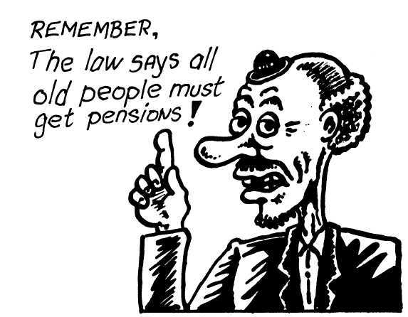
Thank You

